Slide 1
数据链路层服务

Slide 2
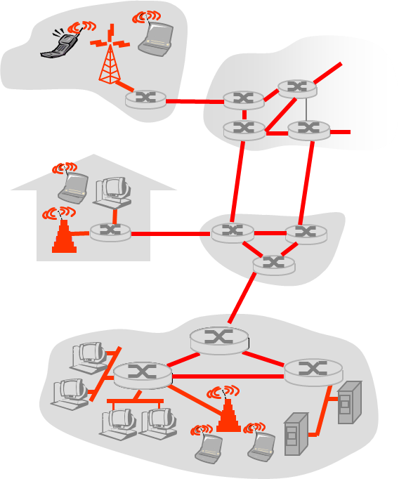
Link Layer: Introduction
Some terminology:
hosts and routers are nodes
communication channels that connect adjacent nodes along communication path are links
wired links
wireless links
LANs
layer-2 packet is a frame, encapsulates datagram
data-link layer has responsibility of
transferring datagram from one node
to adjacent node over a link

Slide 3
Link layer: context
transportation analogy
trip from Princeton to Lausanne
limo: Princeton to JFK
plane: JFK to Geneva
train: Geneva to Lausanne
tourist = datagram
transport segment = communication link
transportation mode = link layer protocol
travel agent = routing algorithm
datagram transferred by different link protocols over different links:
e.g., Ethernet on first link, frame relay on intermediate links, 802.11 on last link
each link protocol provides different services
e.g., may or may not provide rdt over link

Slide 4
Link Layer Services
framing, link access:
encapsulate datagram into frame, adding header, trailer
channel access if shared medium
“MAC” addresses used in frame headers to identify source, dest
different from IP address!
reliable delivery between adjacent nodes
we learned how to do this already (chapter 3)!
seldom used on low bit-error link (fiber, some twisted pair)
wireless links: high error rates
Q: why both link-level and end-end reliability?

Slide 5
Link Layer Services (more)
flow control:
pacing between adjacent sending and receiving nodes
error detection:
errors caused by signal attenuation, noise.
receiver detects presence of errors:
signals sender for retransmission or drops frame
error correction:
receiver identifies and corrects bit error(s) without resorting to retransmission
half-duplex and full-duplex
with half duplex, nodes at both ends of link can transmit, but not at same time

Slide 6
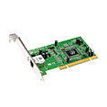
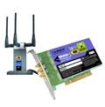
Where is the link layer implemented?
in each and every host
link layer implemented in “adaptor” (aka network interface card NIC)
Ethernet card, PCMCI card, 802.11 card
implements link, physical layer
attaches into host’s system buses
combination of hardware, software, firmware
host schematic
application
transport
network
link
cpu
memory
link
physical
host
bus
(e.g., PCI)
controller
physical
transmission
network adapter
card

Slide 7
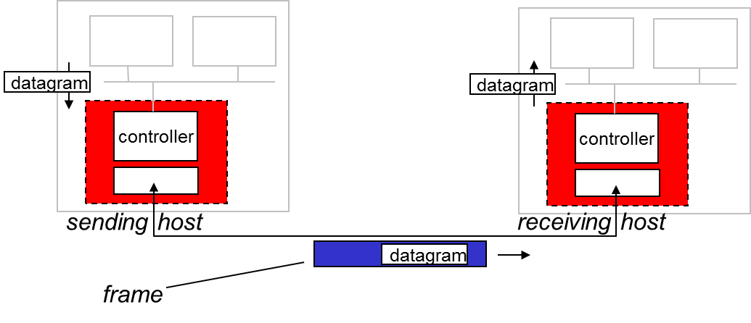
Adaptors Communicating
sending side:
encapsulates datagram in frame
adds error checking bits, rdt, flow control, etc.
receiving side
looks for errors, rdt, flow control, etc
extracts datagram, passes to upper layer at receiving side

Slide 8

Summary
Link Layer Services

